Slide 1
IoT Sensor Data Analysis
Vaibhav Purohit

Slide 2
Introduction
IoT sensor data analysis is a solution to large scale data acquisition and analysis for decision making.
An automated mechanism for industries
Huge amounts of data gathered, stored and analysed automatically.
Result representation at mobile applications for immediate decisions.
Predictive analysis to avoid mishaps.

Slide 3
Agenda
What is the project?
Segmentation of the project
Modular functionality
Inter-Segment communication
RDBMS vs MongoDB
Why the project?
System Architecture (Final Look)

Slide 4

IoT Sensor Data Analysis
The project provides a mobile application representing results of data analysis.
Data is stored and analysed at the HDFS along with a NoSQL database (MongoDB).
The data is generated by large scale placed sensors connected to smart micro-controllers.
These micro-controllers communicate with the database over the internet.
Hence an automated monitoring system over an industry with possible predictive analysis.

Slide 5
Project Segments
Divided into 3-
DATA ACQUISOTION
Raspberry pi microcontroller
(Python)
DATA STORAGE & ANALYSIS
HDFS
+
MongoDB
DATA REPRESENTATION
Android Application

Slide 6
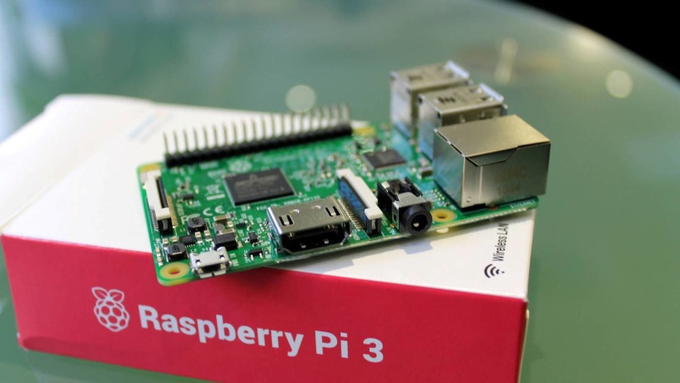
Data Acquisition
Industry parameter sensors placed in huge amounts.
These sensors are all connected to a smart microcontroller.
RaspberryPi gathers data from sensors as per its program.
Collected data is forwarded to the second phase of the project.

Slide 7
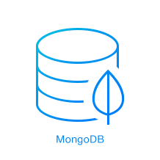
Data Storage & Analysis
MongoDB – a NoSQL document database is used.
Mongo is responsible for the storage of data and communication with the other two segments.
Mounted over the Hadoop Distributed File System.
The HDFS analyses the provided data employing MapReduce functionality over a cluster to get concluded results.

Slide 8
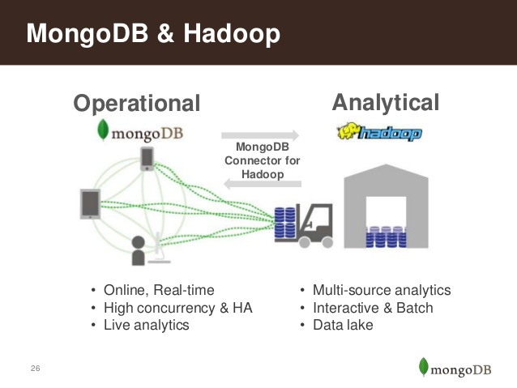
Hadoop & MongoDB
MongoDB connector for Hadoop is available for it to take input and store its output.
Mongo stores the operational data in document databases.
Hadoop uses MapReduce
MR does the analysis.
Integrated functioning.

Slide 9
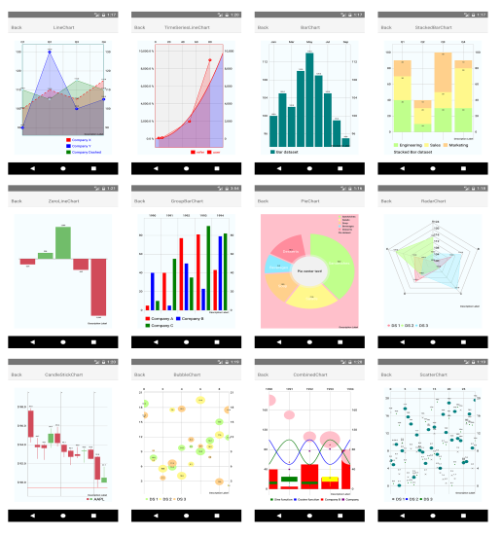
Data Representation
The android based mobile application plays the role of representing the industry working data to its respective personnel.
The concluded data stored in mongo is fetched by the application java program.
The results are then displayed using infographs and charts imparting vital monitoring data.

Slide 10
Inter-Segment Communication
The flow of the project is based on the key functionality of communication.
The divided segments communicate and send data to one another based on different concepts.
Phase 1
Phase 2
Phase 3
Comm. Point 1
Comm. Point 2

Slide 11

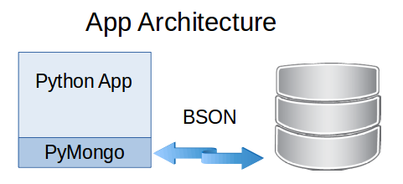
Comm. Point 1 (Python)
Raspberry pi uses python for programming
Pymongo is the driver by PIP (Python Index Package)
Import the class
Creating a Database
db = Sensor.data

Slide 12
Python Functions
Functionality for DB manipulation –
Insert_one
Insert_many
Find_one
Find_many
Updating the DB
result = db.reviews.update_one({'_id' : ASingleReview.get('_id') }
{'$inc': {'likes': 1}})print('Number of documents modified : ' + str(result.modified_count))

Slide 13
Sample Code
Generating Sample
db=Client.Sensor
parameters = [‘Temperature',‘Pressure',‘Humidity', ‘RPM']
Unit_type= [‘.C',‘bar',‘m^3',‘RPM']
Plant_Num = ['Plant 1', ‘Plant 2', ‘Plant 3', ‘Plant 4', ‘Plant 5’]
Sensor = { ‘Parameters' : parameters[randint(0, (len(parameters)-1))] + ' ' + parameters[randint(0, (len(parameters)-1))] + ' ' + company_type[randint(0, (len(company_type)-1))],
‘values' : randint(1, 5),
‘Plant' : Plant_Num[randint(0, (len(Plant_Num)-1))] }
result=db.reviews.insert_one(Sensor)

Slide 14
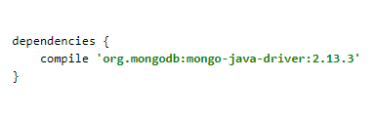

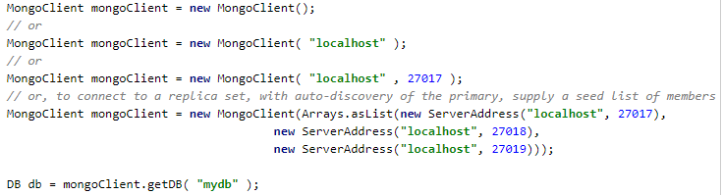
Comm. Point 2 (Java)
The MongoDB Java Driver
Import driver libraries
MongoClient class allows java connection to the MongoDB

Slide 15
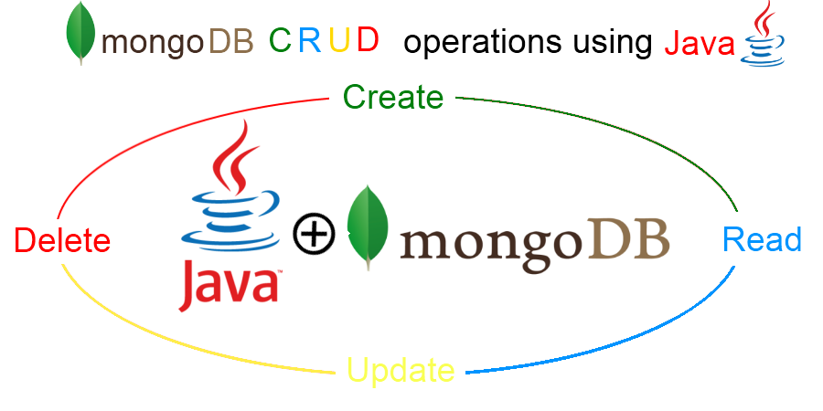
Java Functions
Getting a collection
DBCollection coll = db.getCollection(“Sensor Data");
Inserting a Document
BasicDBObject doc = new BasicDBObject("name", "MongoDB")
.append("type", "database")
.append("count", 1)
.append("info", new BasicDBObject("x", 203)
.append("y", 102));
coll.insert(doc);

Slide 16
Java functions contd…
Getting Documents with Query
BasicDBObject query = new BasicDBObject("i", 71);
cursor = coll.find(query);
try { while(cursor.hasNext())
{ System.out.println(cursor.next()); } }
finally { cursor.close(); }
Find() function allows the extracting of documents from the DB as per the query details.

Slide 17
RDBMS vs MongoDB Analogy
Relational DB
Table view
Row/Record
Column/Attribute
ACID
Atomicity
Consistency
Isolation
Durability
SQL query
Document DB
Collection view
Document
Field
CAP
Consistency
Availability
Partition Tolerance
JSON query also supported

Slide 18
Why?
The app provides a remote and all time monitoring over industry functioning.
No human intervention, hence accuracy.
Event driven immediate decisions.
No human resources in adverse conditions
Consistent and diligent data acquisition.
Predictive analysis to avoid mishaps.
Speedy processing of huge data sets.

Slide 19

System Architecture
A basic look of project flow
Data Acquisition
Data Storage & Analysis
Data Representation
Data Storage
MongoDB
1
Android Application for result representation
2
Micro-controller
3
Data Analysis
HDFS
MapReduce
4

